Slide 1

Downstream spatial data analysis
24 June 2024

Slide 2
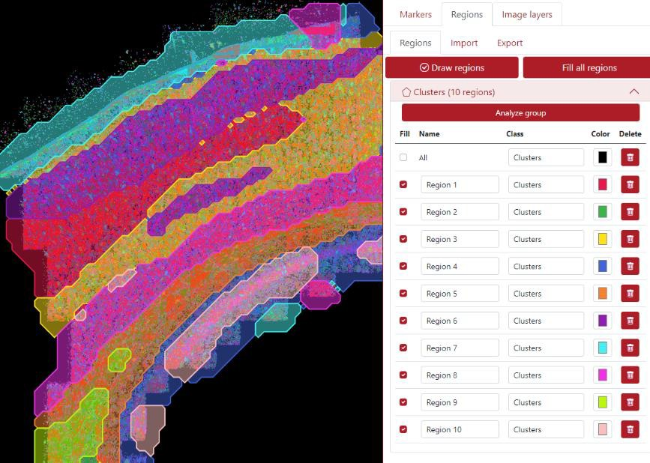
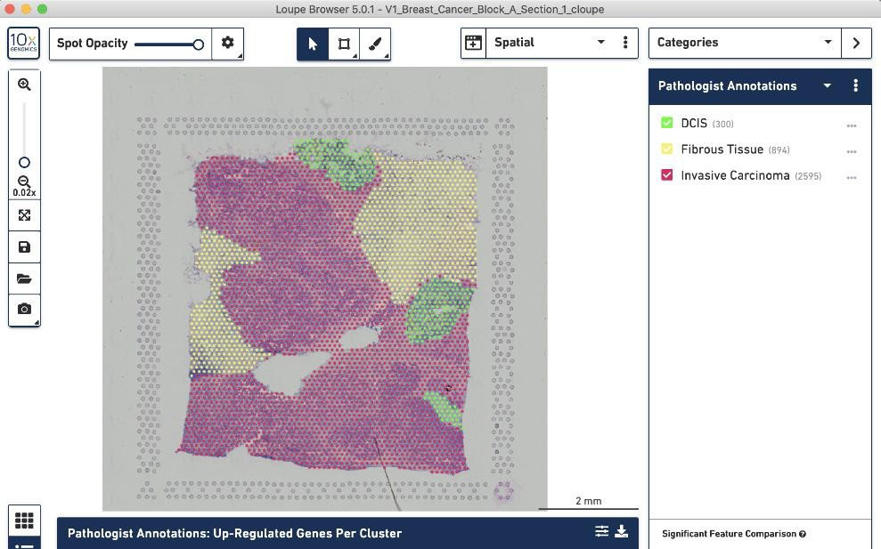
Region-level analysis
Can be manually annotated in QuPath, Napari, TissUUmaps, Loupe
Browser, MACS iQ View, Xenium Explorer, …
Allows comparisons (i.e. DGE, cell type abundances, …) between
regions

Slide 3
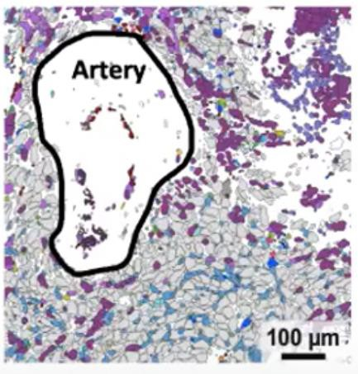
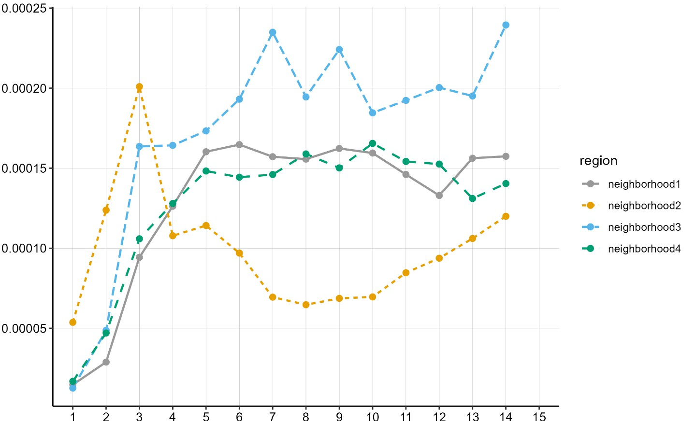

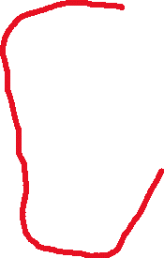





Distance-based analysis
Study the relation between a variable and the distance to a histological feature of interest.
Count/area
Cell type 1
Cell type 2
Cell type 3
Cell type 4
Distance bins

Slide 4
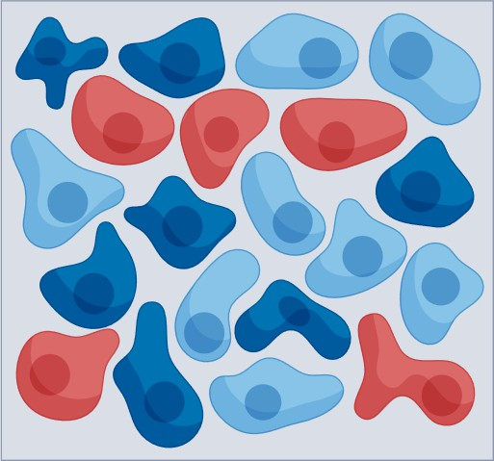
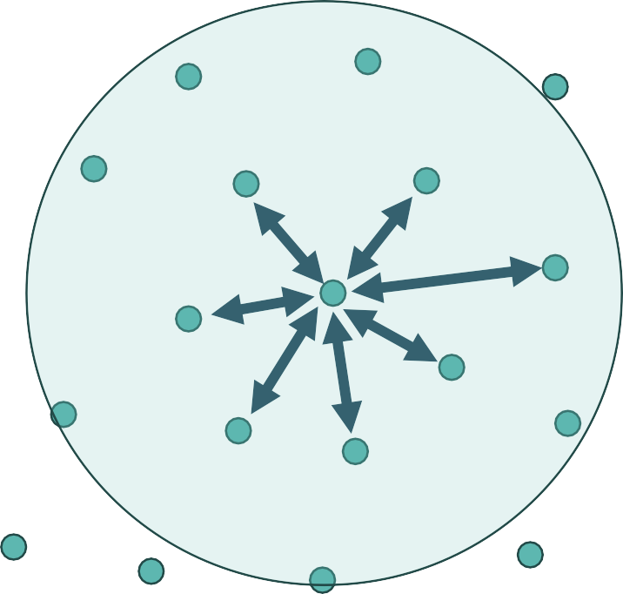
Cell-level analysis: neighborhoods
Study the local neighborhood of cells. Define cells’ neighbors and study their properties, e.g. protein signal intensities, cell types, cell responses, transcripts, features of interest…

Slide 5

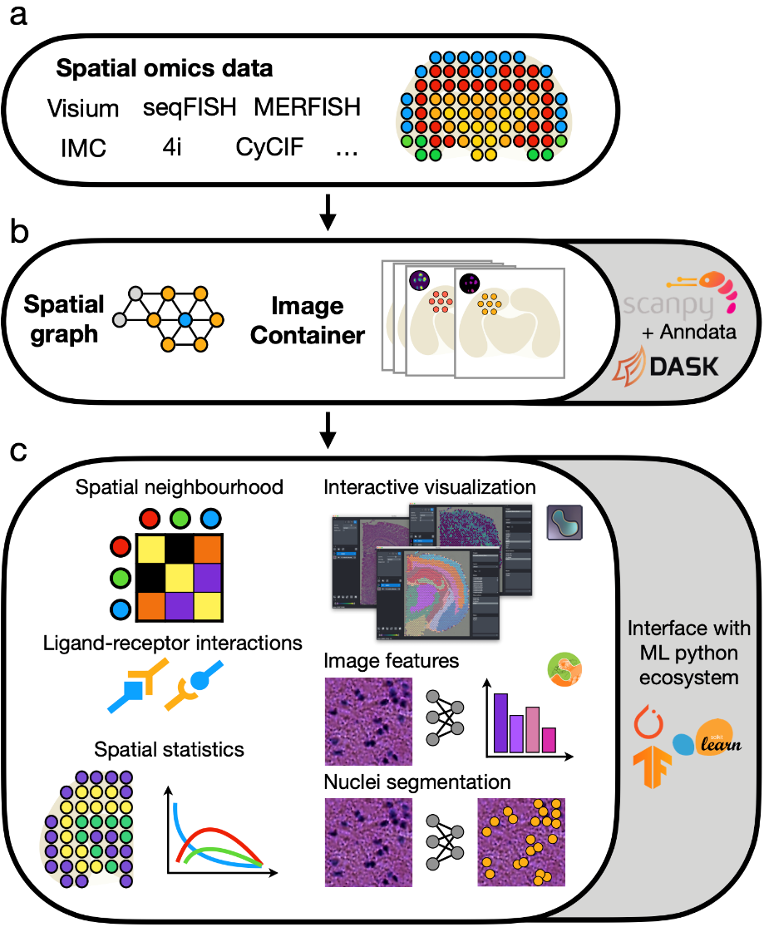
Squidpy
https://squidpy.readthedocs.io
Python package
Tool for the analysis and visualization of spatial molecular data
Part of the scverse, so integrates well with anndata, scanpy, spatialdata)
Giovanni Palla et al.. Squidpy: a scalable framework for spatial omics analysis. Nature Methods, 19(2):171–178, Feb 2022. doi:10.1038/s41592-021-01358-2.

Slide 6
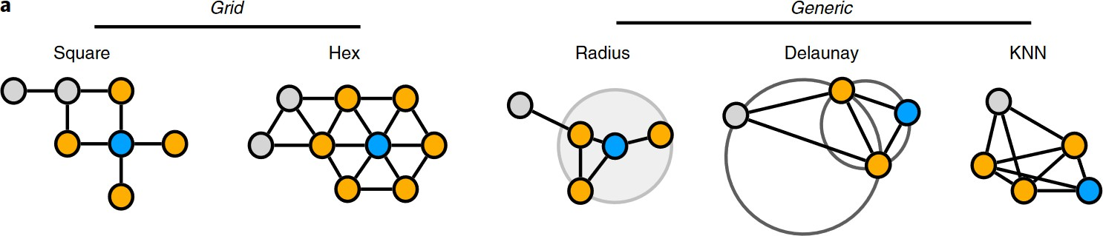
Spatial graphs (1)
A graph of spatial neighbors contains observations (cells or spots) as nodes and neighbor relations between observations as edges.
capture spots locations
cell
locations
Notes:
Neighbors on a grid are typical for spot-based assays (square grid for Visium HD, hexagonal grid for Visium(.
In the generic case, the nodes correspond to segmented cell locations.
See Fig 2.a in https://www.nature.com/articles/s41592-021-01358-2
https://squidpy.readthedocs.io/en/stable/api/squidpy.gr.spatial_neighbors.html#squidpy.gr.spatial_neighbors

Slide 7
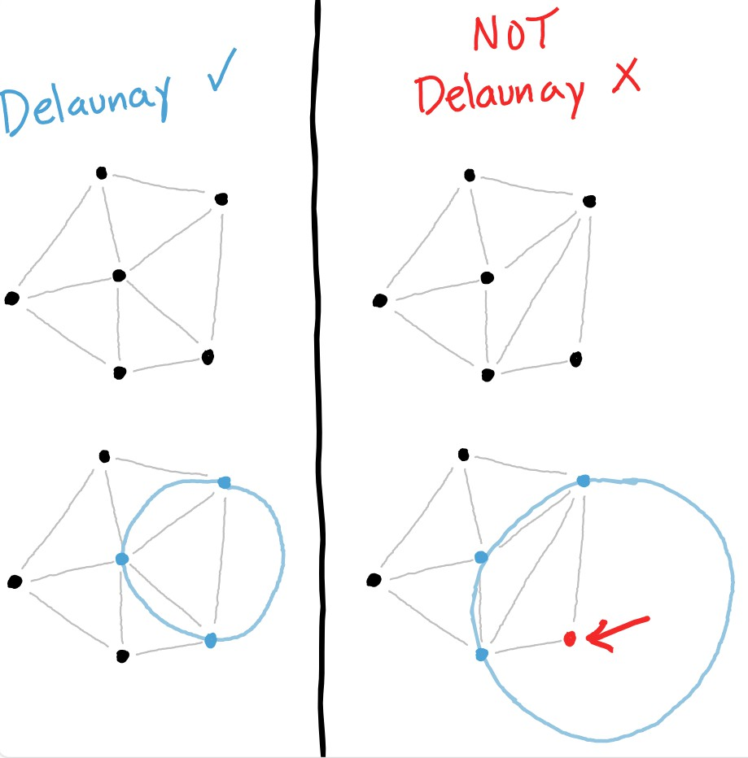
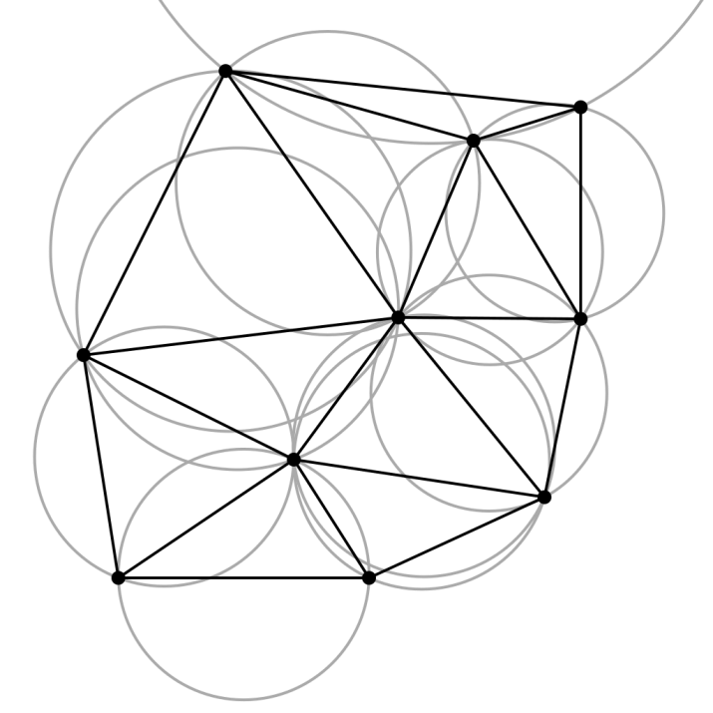
Spatial graphs (2)
Delaunay triangulation: triangulation where no point lies inside any of the circumcircles of the triangles in the network.
Notes:
Delaunay triangulation avoids “sliver” triangles, it maximizes the minimal angle in the triangulation.
The dual of Delaunay triangulation is Voronoi tessellation (whose edges connect the centers of the circumscribed circles).

Slide 8














Spatial graphs (3)
Radius
Delauney triangulation

Slide 9
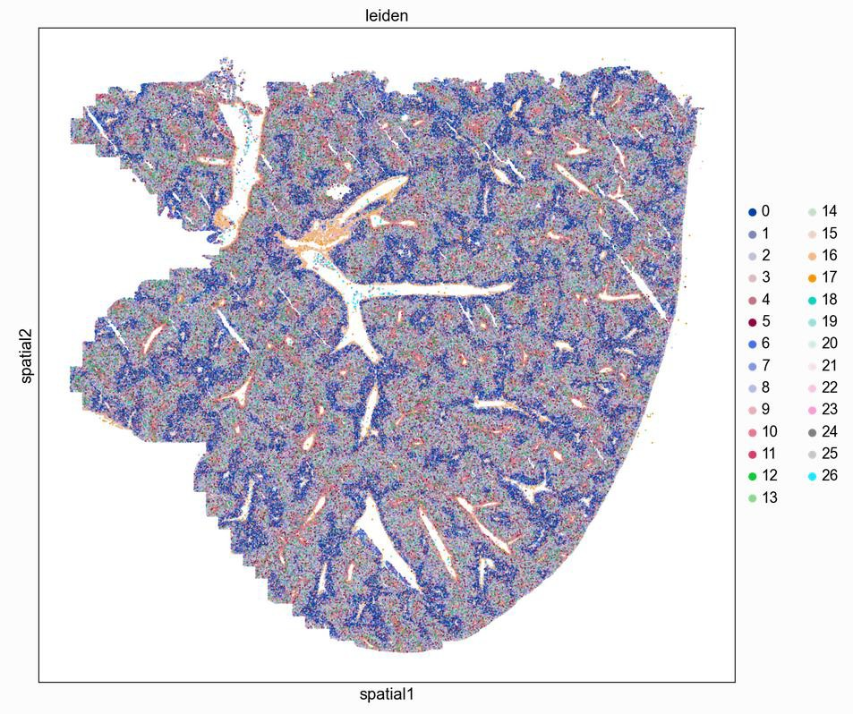
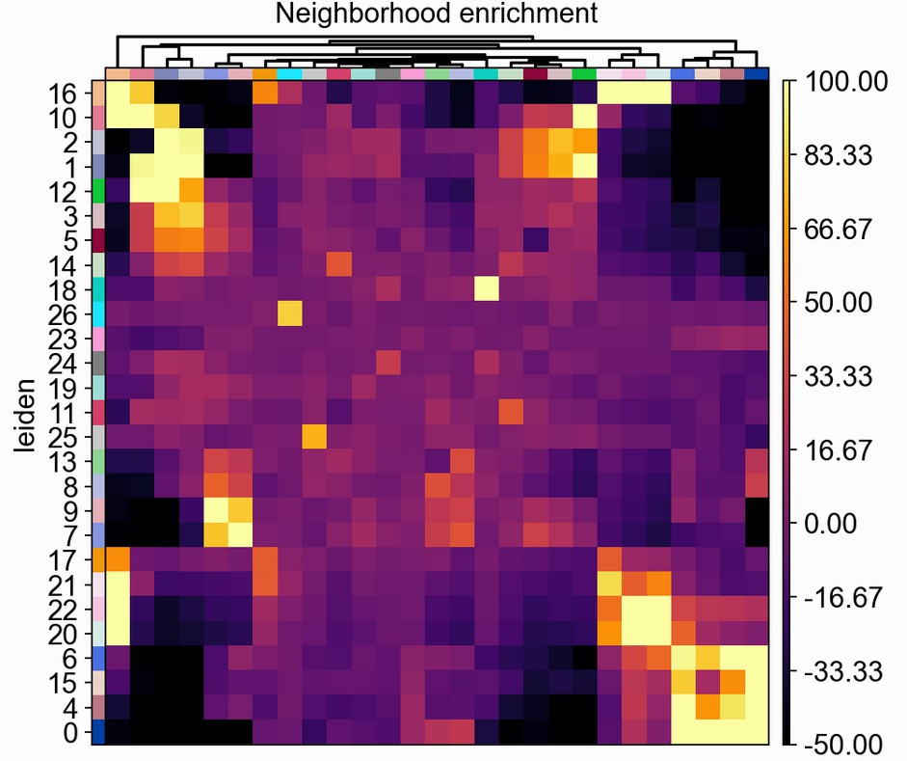
Neighborhood enrichment
A test (score) which determines if cells (or spots) belonging to two different clusters are close to each other more often than expected.
Vizgen, fetal mouse liver
Notes:
See https://squidpy.readthedocs.io/en/stable/notebooks/tutorials/tutorial_vizgen_mouse_liver.html#neighborhood-enrichment
Left: visualization of the Leiden clusters in the context of the liver tissue. Note the zonation pattern, with cells from some clusters near portal and others near central veins.
Right: neighborhood enrichment visualized using a hierarchically clustered heatmap which shows clusters of enriched neighborhoods in our tissue.
“Neighborhood enrichment score: in short, it’s an enrichment score on spatial proximity of clusters: if spots/cells belonging to two different clusters are often close to each other, then they will have a high score and can be defined as being enriched. On the other hand, if they are far apart, the score will be low and they can be defined as depleted. This score is based on a permutation-based test”

Slide 10
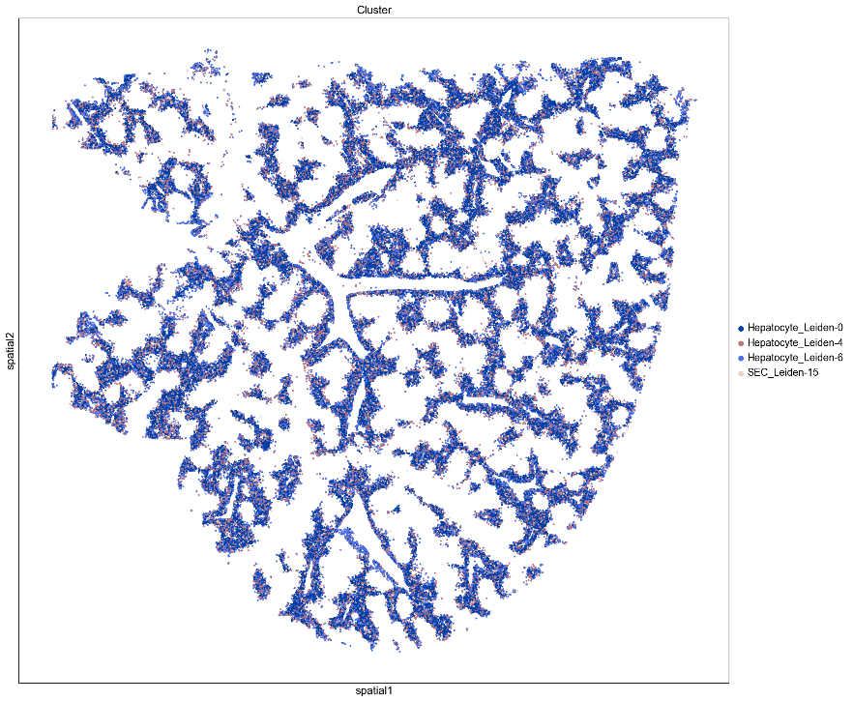
Neighborhood enrichment
peri-portal hepatocytes

Slide 11
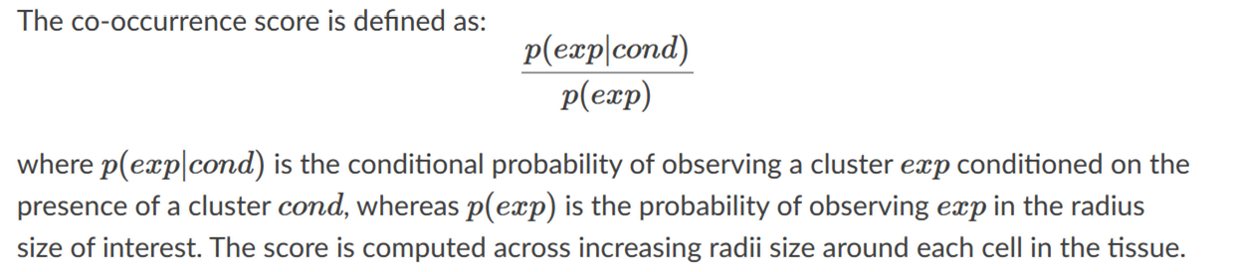
Co-occurrence score
Like neighborhood enrichment, studies which clusters occur close to one another
Does not need a connectivity matrix (spatial graph), uses original spatial coordinates instead
Score depends on radius parameter

Slide 12
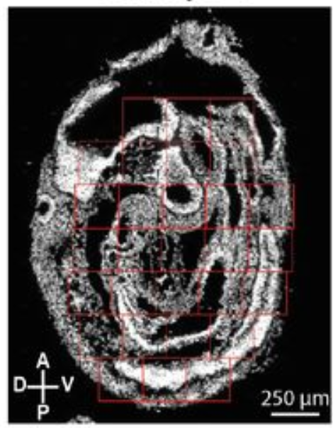
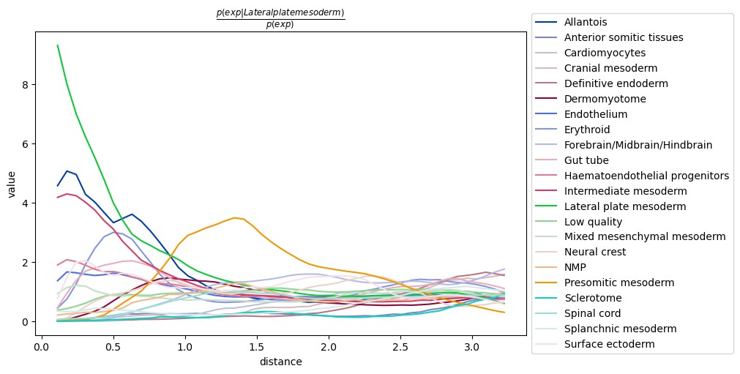
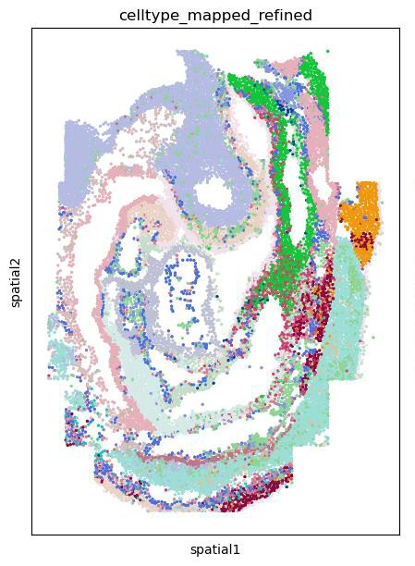
Co-occurrence score: example
8-12 somite stage mouse embryo, DAPI stain
Notes:
“It seems (...) that there is a co-occurrence between the conditional cell type annotation Lateral plate mesoderm and the clusters Intermediate mesoderm and Allantois. It also seems that at longer distances, there is a co-occurrence of cells belonging to the Presomitic mesoderm cluster. By visualizing the full tissue as before we can indeed appreciate that these cell types seems to form a defined clusters relatively close to the Lateral plate mesoderm cells.”
https://squidpy.readthedocs.io/en/stable/notebooks/tutorials/tutorial_seqfish.html#co-occurrence-across-spatial-dimensions
Data from https://www.biorxiv.org/content/10.1101/2020.11.20.391896v1.full

Slide 13
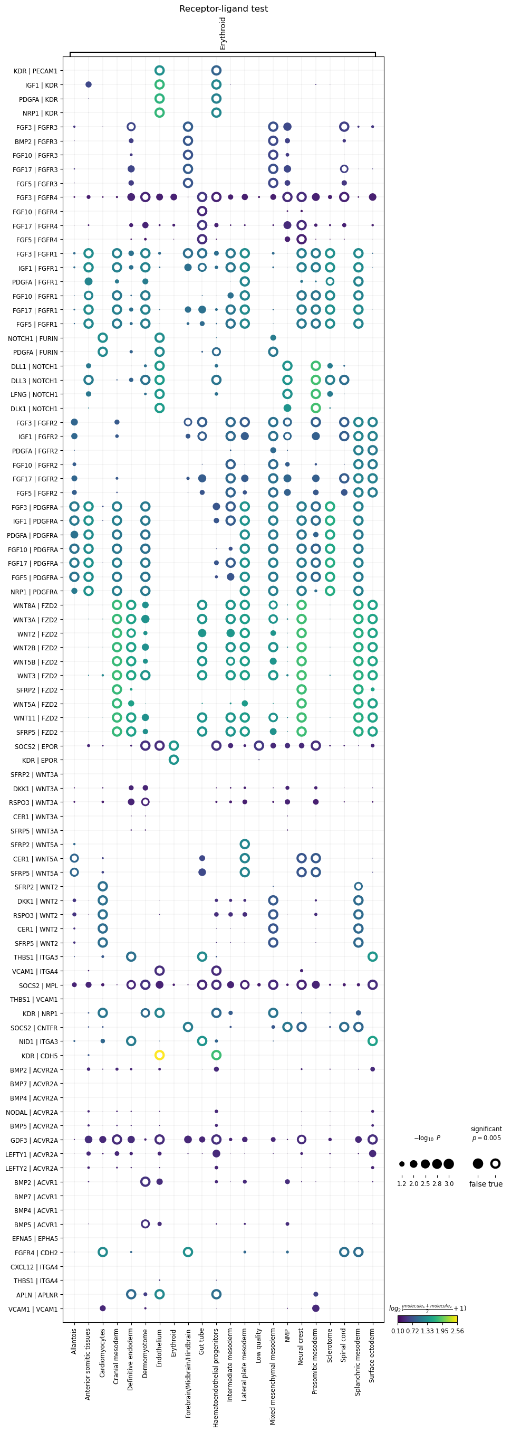
Cell-cell communication (CCC)
Ligand-receptor interaction analysis with Squidpy CellPhoneDB extended with Omnipath database
Circle size = P-value Circle color = average expression level of interacting molecules
Many caveats, try different techniques (see LIANA+)
Notes:
- See https://www.nature.com/articles/s41596-020-0292-x (fig 2) for an overview of the statistical framework of CellPhoneDB
- P-values are indicated by circle size
Color indicates the average expression level of interacting molecules
Example shown is from https://squidpy.readthedocs.io/en/stable/notebooks/examples/graph/compute_ligrec.html

Slide 14
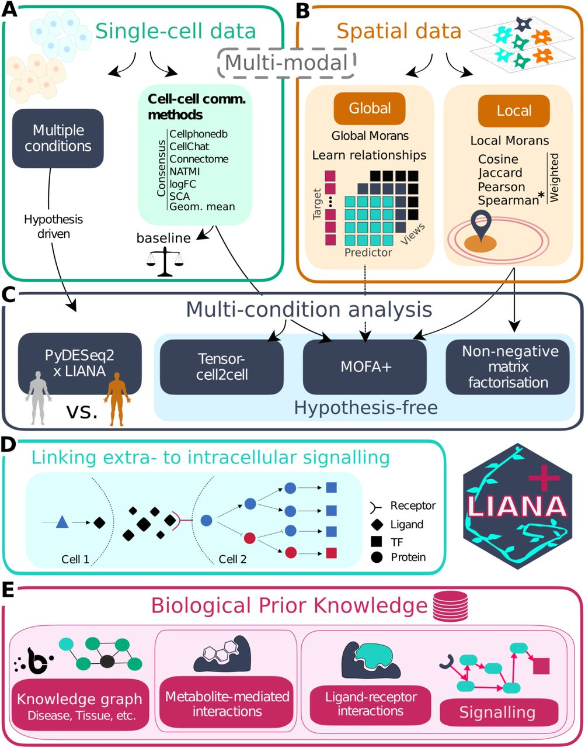
Cell-cell communication
LIANA+
Python
https://github.com/saezlab/liana-py
https://www.biorxiv.org/content/10.1101/2023.08.19.553863v1
Notes:
Abstract: “The growing availability of single-cell and spatially-resolved transcriptomics has led to the rapidly growing popularity of methods to infer cell-cell communication. Many approaches have emerged, each capturing only a partial view of the complex landscape of cell-cell communication.
Here, we present LIANA+, a scalable framework to decode coordinated inter- and intracellular signalling events from single- and multi-condition datasets in both single-cell and spatially-resolved data. Beyond integrating and extending established methodologies and a rich knowledge base, LIANA+ enables novel analyses using diverse molecular mediators, including those measured in multi-omics data. Accessible as an open-source Python package at https://github.com/saezlab/liana-py, LIANA+ provides a comprehensive set of synergistic components to study cell-cell communication.”
https://liana-py.readthedocs.io/en/latest/notebooks/sma.html

Slide 15
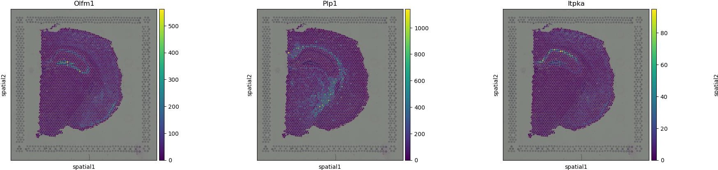
Spatial autocorrelation
Global spatial autocorrelation statistics (Moran’s I or Geary’s C) : can be used to identify whether genes have a non-random spatial expression pattern in the tissue.
High positive autocorrelation
Visium

Slide 16
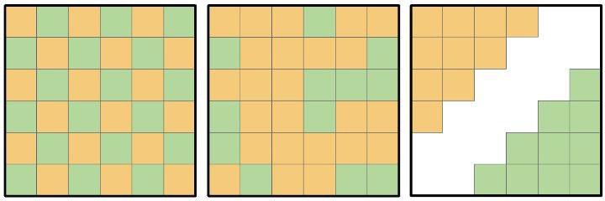
Spatial autocorrelation: Moran’s I
Moran’s I lies between -1 and +1. Values close to -1 indicate negative spatial autocorrelation, while values close to +1 indicate positive spatial autocorrelation.
Dispersed
Random
Clustered
I=-1
I=0
I=1
Notes:
https://en.wikipedia.org/wiki/Moran%27s_I

Slide 17
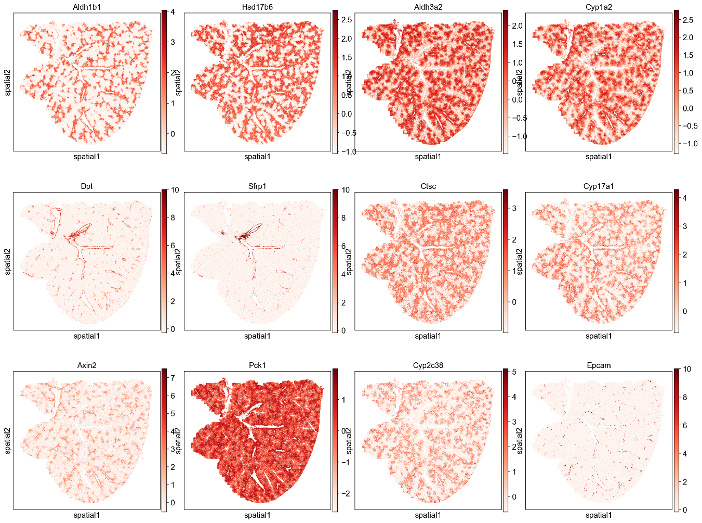
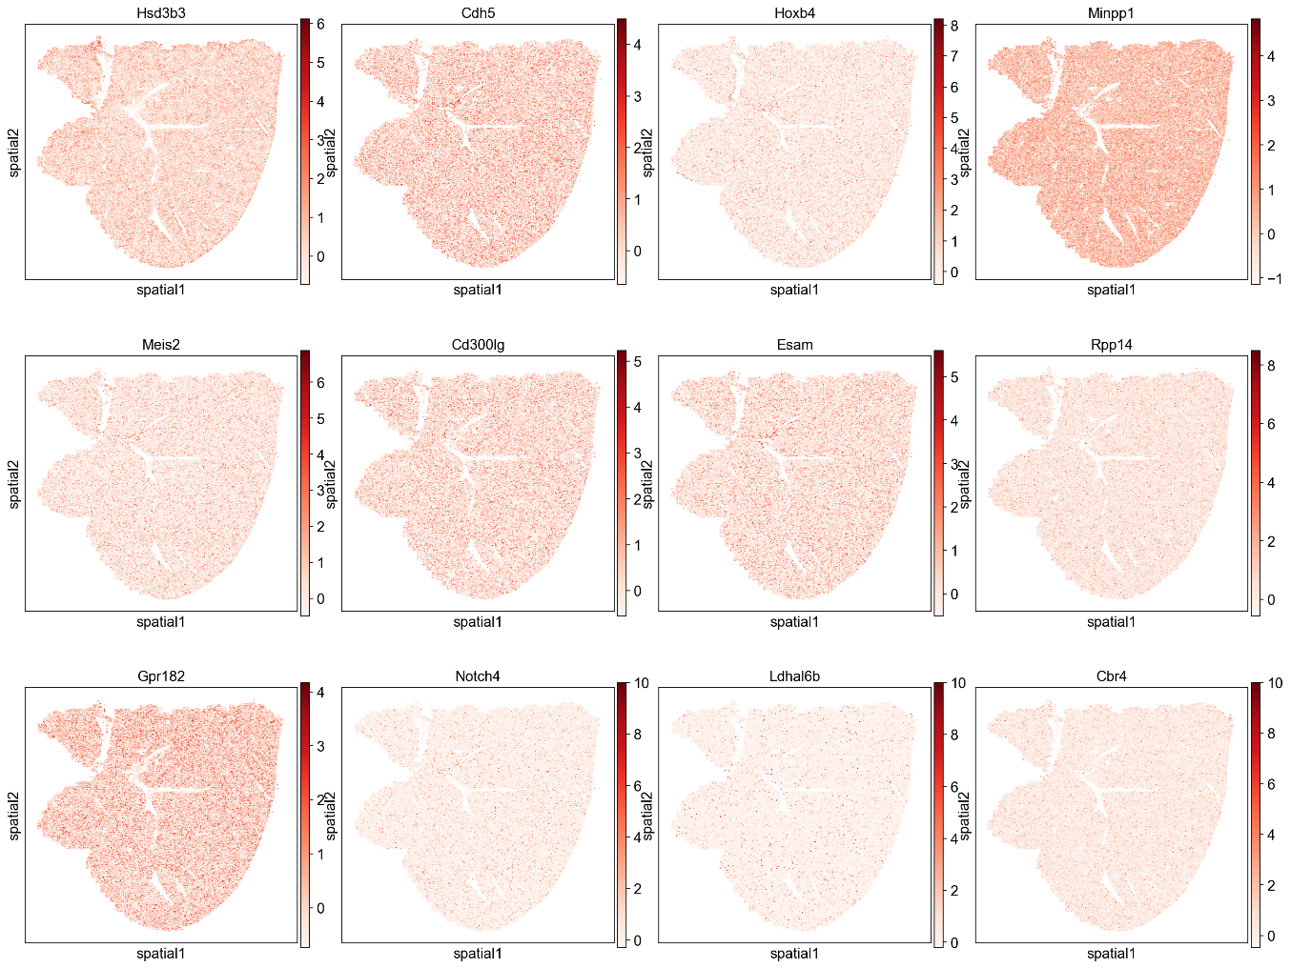
Moran’s I example: Vizgen liver sample
Top genes with highest spatial autocorrelation (hepatocytes and blood vessel associated cell types)
Top genes with lowest spatial autocorrelation
Notes:
Example from https://squidpy.readthedocs.io/en/stable/notebooks/tutorials/tutorial_vizgen_mouse_liver.html#autocorrelation-moran-s-i-score
“We note that many of the top scoring genes show expression patterns following the spatial pattern of hepatocyte Leiden clusters (e.g. Aldh1b1, Aldh3a20) and blood vessels (e.g. Dpt, Sfrp1). We can also check which cell types are most associated with these highly auto-correlated genes by ranking cell clusters based on their expression of these genes (e.g. mean expression). Below we see that three of the top five cell clusters are hepatocytes, which agrees with the gene’s localization patterns. These results indicate the primary spatial patterns in gene expression auto-correlation are being driven by their expression in hepatocytes and blood vessel associated cell types.”

Slide 18
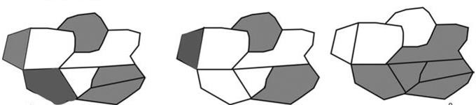
Spatial autocorrelation: Geary’s C
Geary’s C lies between 0 and values above 1. Values significantly below 1 indicate positive spatial autocorrelation, while values significantly higher than 1 indicate negative spatial autocorrelation.
Dispersed
Random
Clustered
C=2
C=1
C=0
Notes:
https://en.wikipedia.org/wiki/Geary%27s_C

Slide 19
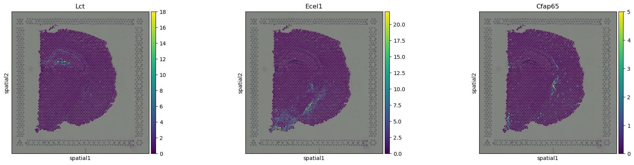
Sepal scores
Sepal scores can be used to identify spatially variable genes (similar use-cases as Moran’s I and Geary’s C, but diffusion process).
Can only be used for grid-like spatial graphs
Filter out low expressed genes (otherwise mistaken for spatially variable)
Alma Andersson, Joakim Lundeberg, sepal: identifying transcript profiles with spatial patterns by diffusion- based modeling, Bioinformatics, Volume 37, Issue 17, September 2021, Pages 2644–2650, https://doi.org/10.1093/bioinformatics/btab164
High sepal scores
Visium
Notes:
Example from https://squidpy.readthedocs.io/en/stable/notebooks/examples/graph/compute_sepal.html#compute-sepal-score

Slide 20
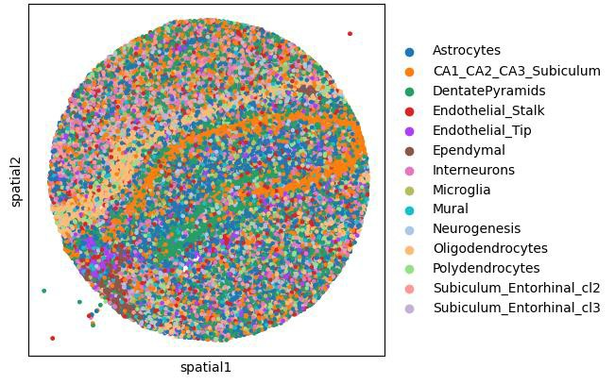
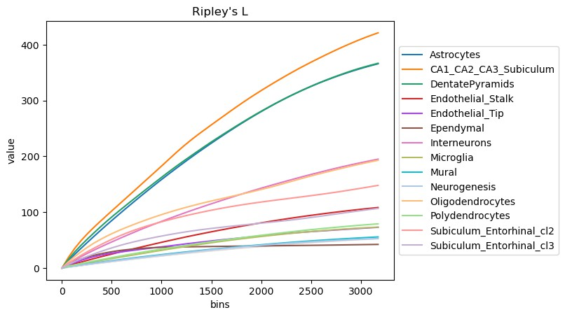
Ripley’s statistics
Ripley’s statistics (Ripley’s F, G and L) are used to determine if discrete annotations (e.g. clusters, cell types, …) have random, dispersed or clustered patterns over different scales.
High values seem to indicate more clustered patterns
=
distance
Notes:
https://squidpy.readthedocs.io/en/stable/notebooks/examples/graph/compute_ripley.html

Slide 21
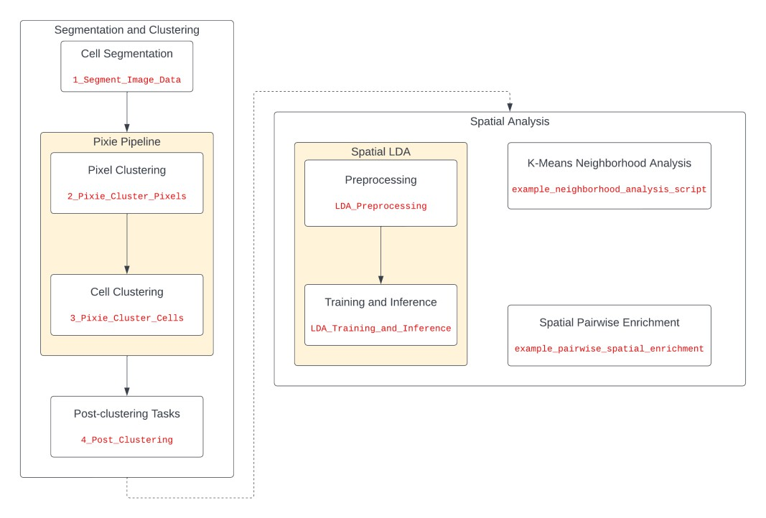
Ark analysis
https://ark-analysis.readthedocs.io/en/latest/
Michael Angelo lab (Stanford)
Toolbox for analyzing multiplexed imaging data.
https://www.youtube.com/wat ch?v=HQAkS7kbzH8&t=3662s
Notes:
Pixel clustering (pixie) paper: https://www.nature.com/articles/s41467-023-40068-5
-Pairwise distance analyses: identifying enrichments between specific populations
-K-means neighborhood analysis: identifying cellular neighborhoods
-Spatial-LDA neighborhood analysis: advantages/disadv. of spatial-LDA compared to K-means
CPM: Cell Phenotype Map (clusters overlaid on tissue)

Slide 22
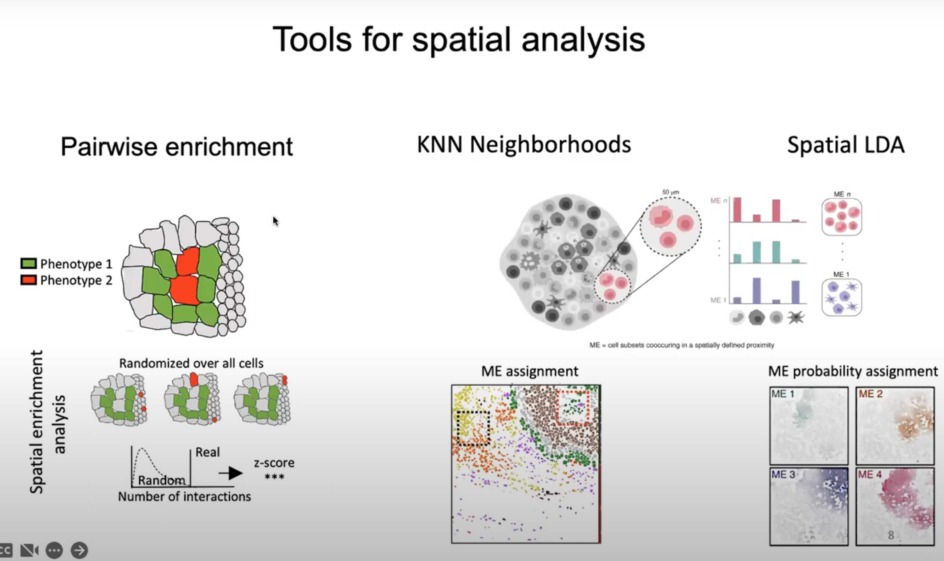
Ark: tools for spatial analysis
Notes:
Pairwise enrichment: useful when one is interested in which cell types might be interacting, because those will likely also preferentially be spatially enriched for one another.
KNN neighborhoods and Spatial LDA: useful to study the overall tissue architecture, like for tumor microenvironment etc.
KNN: simpler than spatial LDA, and faster; easy to interpret: exactly 1 microenvironment per cell
Spatial LDA: harder to interpret and use further downstream still because of probabilities; but better identification of the behavior at the boundaries of larger microenvironments.

Slide 23
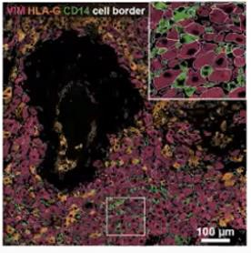
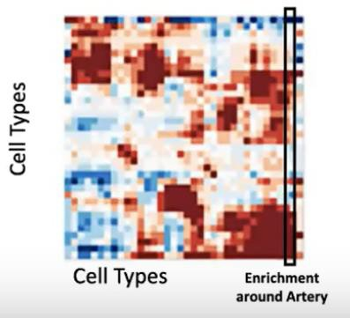
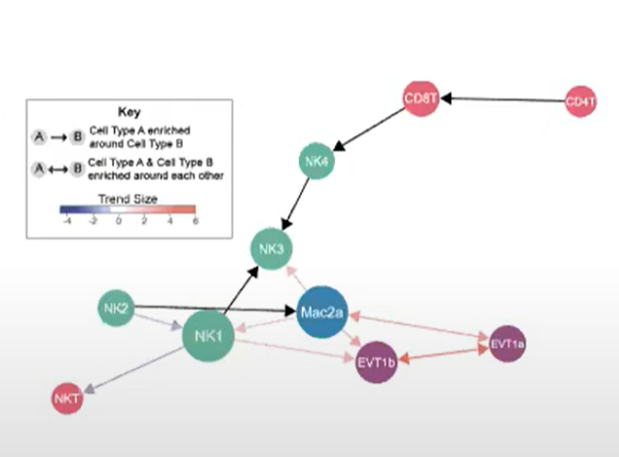
Ark – pairwise enrichment
cell-cell enrichment: investigating whether cell types are found in close proximity to each other more often than chance.
cell-histological feature enrichment: studying whether cell types are enriched around a particular feature (e.g. arteries, glands, tumors, …).
Notes:
https://www.youtube.com/watch?v=HQAkS7kbzH8&t=3662s

Slide 24
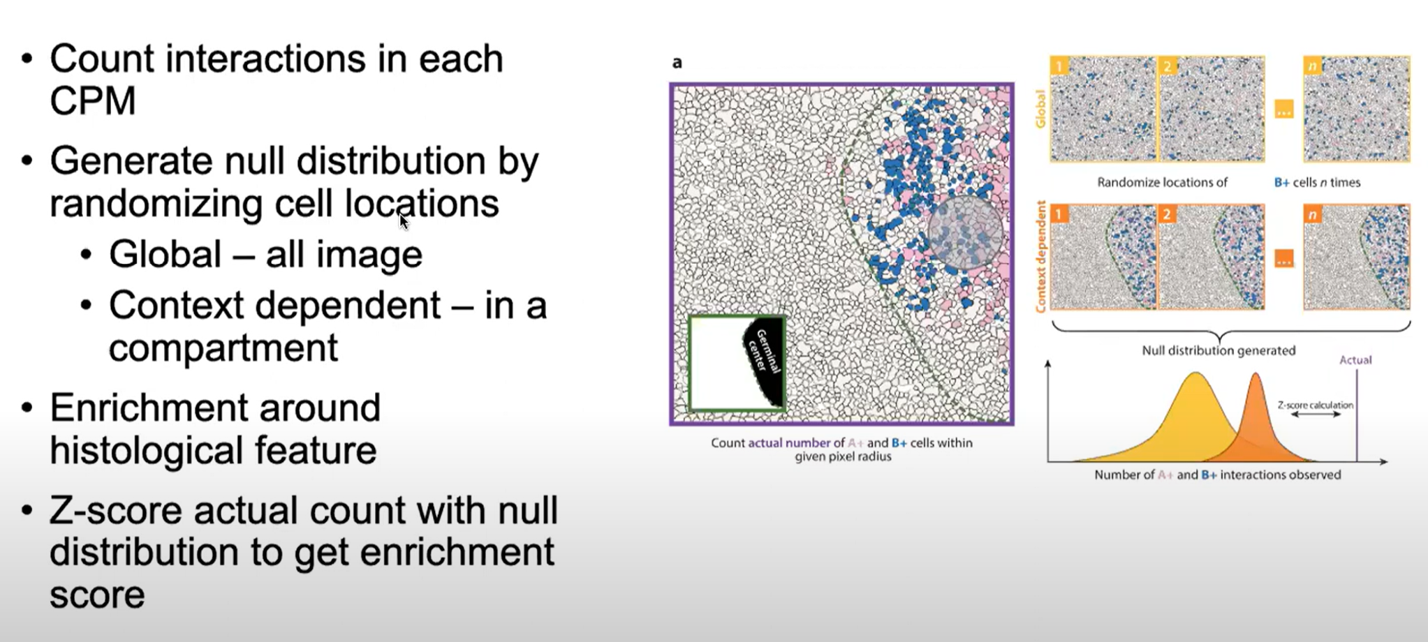
Ark – pairwise enrichment algorithm
(Cell Phenotype Map)
Notes:
CPM: Cell Phenotype Map (cell cluster id shown on top of the segmented image)

Slide 25
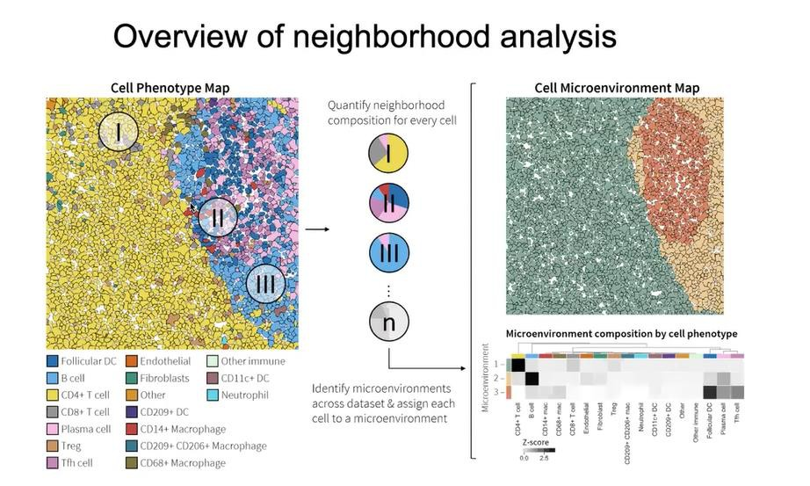
Ark – neighborhood analysis: K-means
Unsupervised clustering method that assigns a single micro- environment to cells based on the cell type abundances around each cell. The number of microenvironments and the influence distance have to be specified.
Notes:
See https://www.youtube.com/watch?v=HQAkS7kbzH8&t=3662s, from 35:00:00 onward.
What is neighborhood (microenvironment) analysis?
- “Cells are regulated in part by their local cellular niche.”
“Collections of cell phenotypes are found to be spatially colocalized and conserved across datasets”
For each cell in CPM, count proportion of cell types around it. Then cluster these new feature vectors. Each color on the left picture is a cell type, but in the picture on the right each cell is colored by its microenvironment.

Slide 26
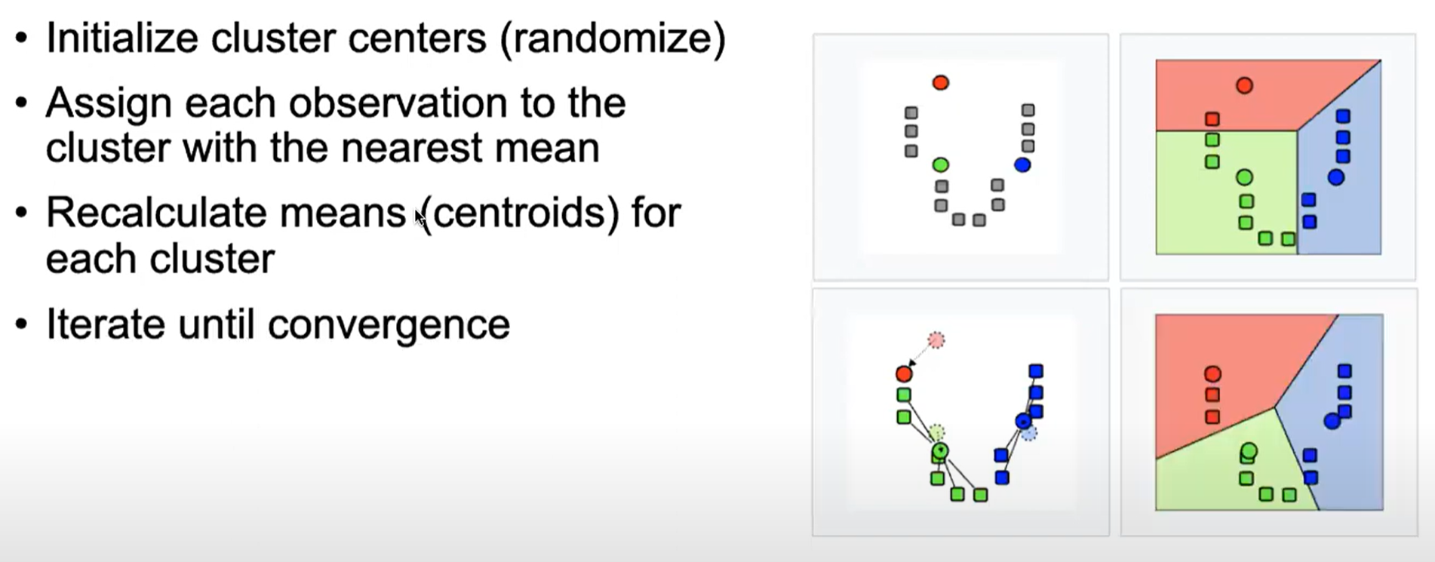
Ark – neighborhood analysis: K-means clustering – algorithm
Notes:
Picking the number of clusters: see https://www.youtube.com/watch?v=HQAkS7kbzH8&t=3662s around 42:00

Slide 27
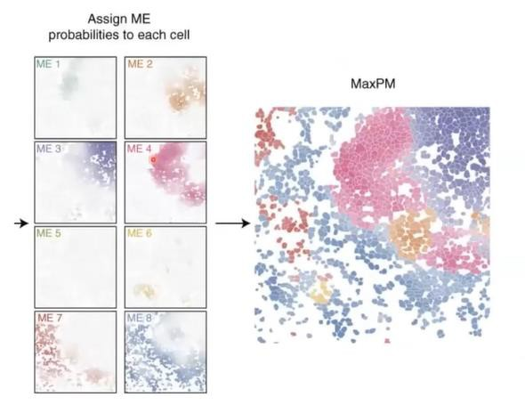
Ark – neighborhood analysis: spatial LDA (Latent Dirichlet Allocation)
Similar to K-means neighborhood analysis, but spatial LDA output a probability distribution for cells belonging to each of the micro- environments.
Allows smooth transitions between microenvironments
Unsupervised
Computationally expensive
Hyperparameters: neighborhood radius, # microenvironments
Notes:
It drops the restriction of K-means clustering based neighborhood analysis that different microenvironments are spatially separate and never overlap or share cells. So it allows smooth transitions between microenvironments.
Spatial LDA hyperparameters: radius of neighborhood, and # microenvironments

Slide 28
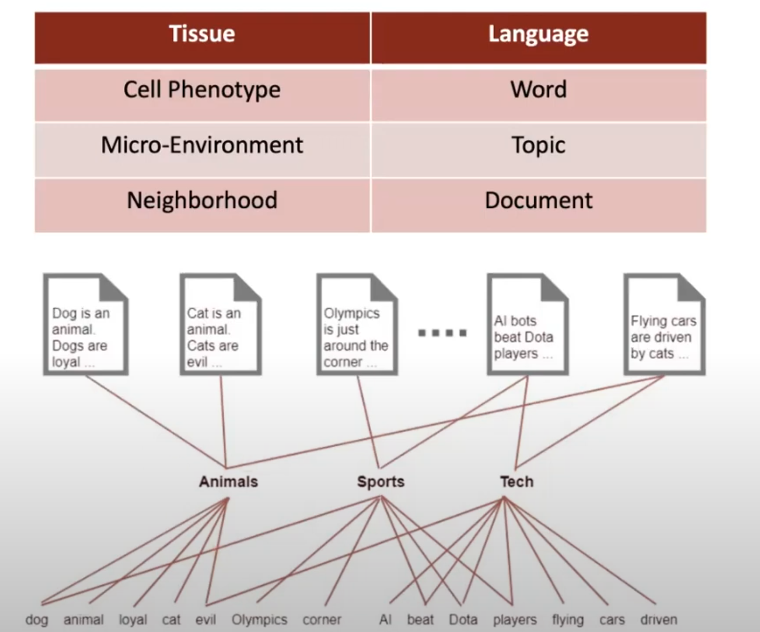
Spatial LDA: algorithm background
LDA goal in spatial analysis: find microenvironments that a cell’s neighborhood belongs to, based on the cell phenotypes in the neighborhood.
LDA represents neighborhoods as mixtures of microenvironments.
LDA calculates the probability of each cell phenotype to belong to a microenvironment.
The number of microenvironments is pre-defined.
LDA goal in natural language processing: find topics that a document belongs to, based on the words in the document.
LDA represents documents as mixtures of topics.
LDA calculates the probability of each word to belong to a topic.
The number of topics is pre-defined.
(unsupervised algorithm)

Slide 29
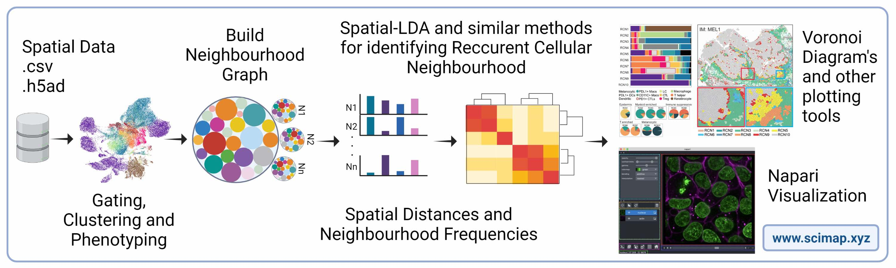
SCIMAP
Multiplexed imaging data analysis
Python-based
Part of MCMICRO (https://mcmicro.org)
Notes:
https://scimap.xyz/
https://joss.theoj.org/papers/10.21105/joss.06604#

Slide 30

Giotto Suite
https://drieslab.github.io/Giotto/
https://www.youtube.com/watch?v=vJhZtfTDK9I
R package
Content:
Spatial enrichment Spatial networks/grids
Spatial expression patterns Co-expression
Neighborhoods
…

